Slide 1
SCA: trivy
ow

Slide 2
What is software composition analysis?
Software composition analysis is an application security methodology that tracks and analyzes open source software components. Fundamentally, SCA tools provide insight into open source license limitations and possible vulnerabilities in your projects. These tools help organizations stay abreast of critical tasks, including security, license compliance, and code quality, to minimize risk.
Software composition analysis provides three core capabilities:
Build a software bill of materials (SBOM) to establish a detailed inventory of your open source software packages.
Verify license compliance requirements by determining what open source software you’re using and where it originated.
Discover detailed information about key vulnerabilities in your source code and provide applicable remediation suggestions.

Slide 3
How does software composition analysis work?
SCA tools work by running scans on a code base and creating a vulnerability analysis. The analysis outputs an SBOM that lists software components and their respective licenses.
In addition, the scan inspects files to find vulnerable third-party libraries and provides insight into open-source dependencies. The technology then compares the SBOM with other vulnerability databases to pinpoint critical vulnerabilities
For example, an organization that needs to establish a comprehensive security and compliance baseline can use software composition analysis to attain baseline license compliance and reveal security vulnerabilities. As teams further develop their code, they can use SCA to maintain license compliances and ensure consistent security.

Slide 4
sbom
In today’s digital age, every piece of software we use is like a puzzle made of different smaller parts from various sources. A Software Bill of Materials (SBOM) is a list that tells exactly what these parts are.
If there’s something bad in the software, like a security weakness, the SBOM helps us find and fix it quickly, keeping our computers and information safe.
An SBOM can help us find out where the bad part is in the software so we can fix it before it causes problems.

Slide 5
definition
A Software Bill of Materials (SBOM) is a complete, formally structured list of components, libraries, and modules that are required to build (i.e. compile and link) a given piece of software and the supply chain relationships between them. These components can be open source or proprietary, free or paid, and widely available or restricted access.
Software producers use SBOMs to help create and maintain the software they deliver. Software buyers use SBOMs to evaluate software before purchasing, negotiate discounts, or plan how to deploy it.
Software operators use SBOMs to manage vulnerabilities, track assets, handle licensing and compliance, and quickly identify dependencies and supply chain risks in the software and its components.

Slide 6
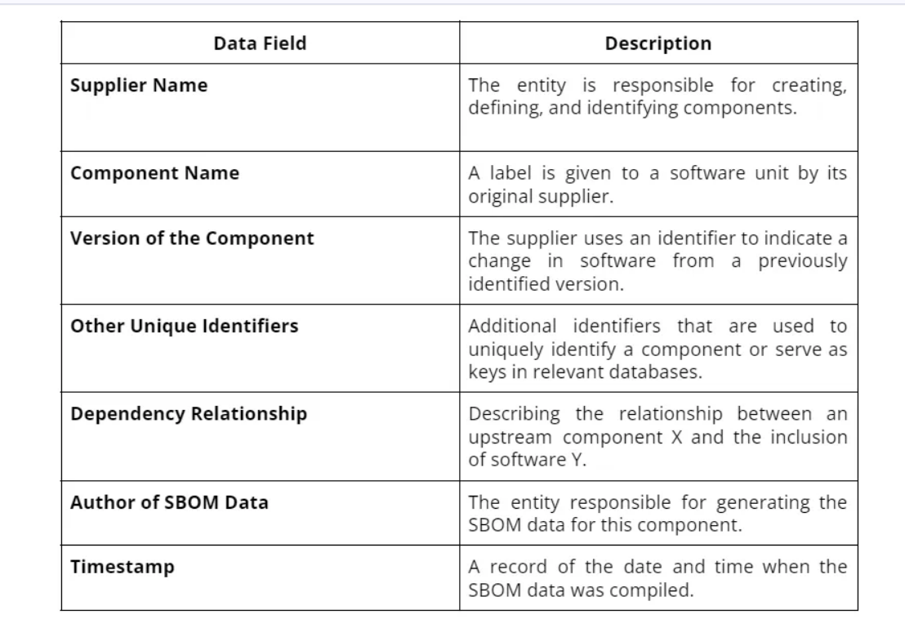
Fields of sbom

Slide 7
Lab for sbom
Setup env
Run test

Slide 8
Trivy overview
Trivy is an open-source vulnerability scanner specifically designed for containers.
It is a lightweight and easy-to-use tool that helps identify vulnerabilities in container images and filesystems.
Trivy focuses on scanning container images for known vulnerabilities in the installed packages and libraries.

Slide 9
..
Comprehensive vulnerability database: Trivy maintains an extensive vulnerability database, which it uses to compare the installed packages and libraries in a container image against known vulnerabilities. It supports various vulnerability databases, including CVE (Common Vulnerabilities and Exposures), Red Hat Security Data, and Ubuntu Security Notices.
Fast and efficient scanning: Trivy is designed to be fast and efficient, providing quick scan results for container images. It leverages a vulnerability detection method called static analysis, which helps expedite the scanning process.

Slide 10
..
Easy integration: Trivy can be easily integrated into your CI/CD pipeline or used as a standalone tool. It supports scanning local Docker images, remote container registries, and filesystems.
Multiple output formats: Trivy provides scan results in multiple output formats, such as JSON, table, and template, allowing you to choose the format that best suits your needs. This makes it easy to integrate Trivy with other tools or processes.

Slide 11
..
Trivy has scanners that look for security issues, and targets where it can find those issues.
Scanners :
OS packages and software dependencies in use (SBOM)
Known vulnerabilities (CVEs)
IaC issues and misconfigurations
Sensitive information and secrets
Software licenses

Slide 12
Trivy Security Scanning Process
GitHub (trivy-db)
Container Registry/Engine
1. Download Trivy DB
2. Pull missing layers in cache
Trivy
3. Analyze layers & store in cache
4. Apply layers
5. Detect security issues

Slide 13
lab

